Slide 1
Assessment for the future
Anton Béguin, International Baccalaureate
Dominique Turner, International Baccalaureate
17 January 2023

Slide 2
Overview
Functions of assessment
Digital assessments: examples from the Middle Years Program (MYP)
Wider digital potential

Slide 3
Functions of assessment

Slide 4
Paul Newton identified 22 different purposes
social evaluation | transfer | resource allocation
formative | placement | organizational intervention
student monitoring | qualification | program evaluation
diagnosis | selection | system monitoring
provision eligibility | licensing | comparability
screening | certification | national accounting
segregation | school choice
guidance | institution monitoring
Newton, P.E. (2007). Clarifying the purposes of educational assessment. Assessment in Education, Vol. 14, Nr. 2, pp. 149-170

Slide 5


Slide 6




What is evaluated?
For who is this important?
Student
Class / Teacher
School
System

Slide 7

Is it high stakes?
Serious impact for a (group of) stakeholders
Not easily remediated without costs / impact
Generated using Dall-E ( https://labs.openai.com/ )

Slide 8

Functions of assessments
Certification / Qualification
Progress
Accountability
Formative Evaluation
&
© Cito, 2019
Notes:
Progress: benchmark or interim assessments
Certification: summative assessment
Accountability: national assessments
“Formative assessments, also known as “classroom assessments,” are in some ways easier to define by what they are not. They’re not like the long, year-end, state-administered, standardized, No Child Left Behind Act-required exams that testing professionals call “summative.” Nor are they like the shorter, middle-of-the-year assessments referred to as “benchmark” or “interim” assessments.
Or they shouldn’t be, at least according to experts inside and outside the testing industry, who believe that truly “formative” assessments must blend seamlessly into classroom instruction itself.”
Test-makers label off-the shelf commercial products as ‘formative assessment’. That has nothing to do with formative assessment

Slide 9
Quality criteria for assessments differ based on the function
Certification / Qualification
reliable / comparable between students
Progress
vertical comparison / actionable (remediation / differentiation)
Accountability
accurate at overarching level ➔ relevant sample of students
Formative Evaluation
provide information actionable in learning (feedback / feed forward)
All assessments need to be valid = claims in line with the information collected

Slide 10
Formative Evaluation: Central principle
Where do I need to go?
Where am I now?
How do I get there?
Wools, S. & Van den Broek, D. (2017). Formatief Toetsen
Notes:
Waar sta ik nu: in termen van niveau, of van beheerste elementen, of puur wat is mijn voorkennis? → Feedback
Dan lonkt de vraag: zijn we er al bijna? Pas als je weet waar je heen gaat kun je die vraag beantwoorden.
Waar moet ik naar toe: gedeeld begrip van de volgende stap, of zelfs eindniveau – hoe krijg ik er zicht op waar ik naar toe moet? → Feedup
Hoe kom ik daar? → Feedforward

Slide 11
Formative Evaluation: Central principle
Where do I need to go?
Feedback
Feed-forward
Where am I now?
Feed-up
How do I get there?
Wools, S. & Van den Broek, D. (2017). Formatief Toetsen
Notes:
Waar sta ik nu: in termen van niveau, of van beheerste elementen, of puur wat is mijn voorkennis? → Feedback
Waar moet ik naar toe: gedeeld begrip van de volgende stap, of zelfs eindniveau – hoe krijg ik er zicht op waar ik naar toe moet? → Feedup
Hoe kom ik daar? → Feedforward

Slide 12
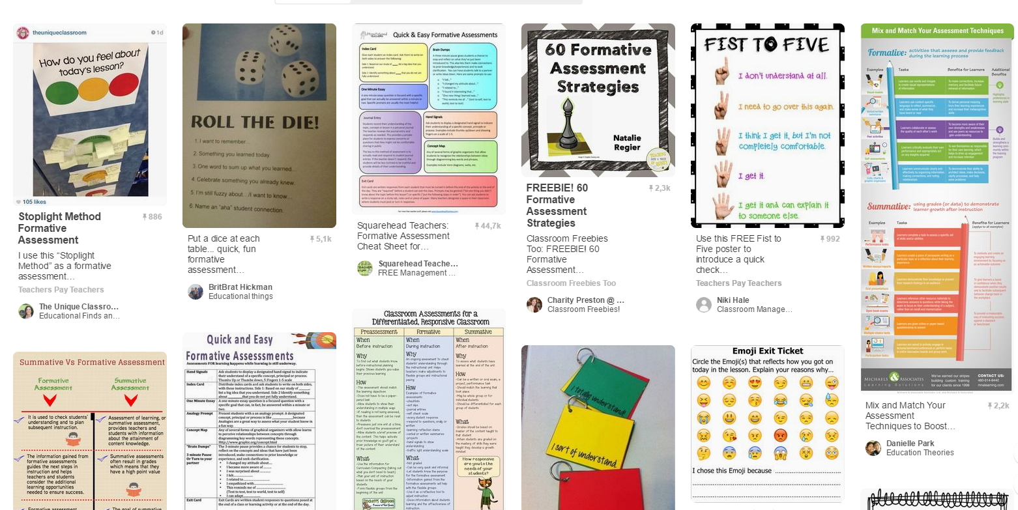

Slide 13
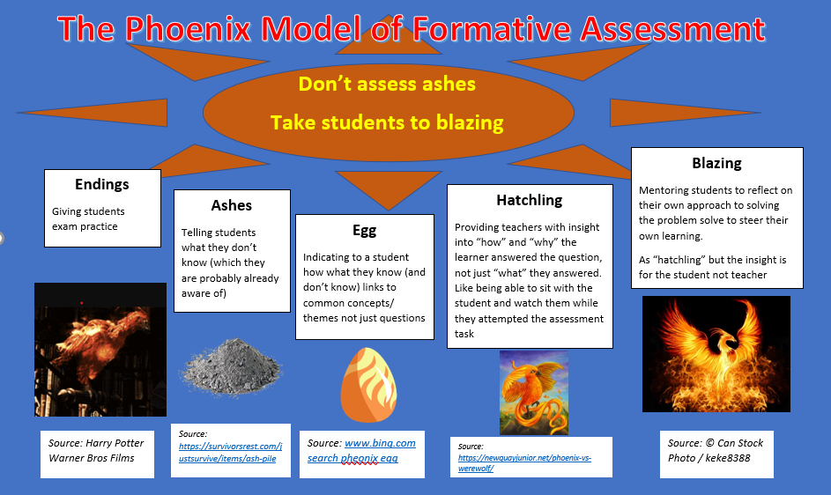
Notes:
Think about formative as more than just exam practice

Slide 14
Digital assessments: examples from the Middle Years Program (MYP)

Slide 15

What are the principles of an IBMYP education?
Notes:
The MYP is a programme for students aged 11 to 16, which aims to "make practical connections between their studies and the real world, and to prepare them for success in further study and in life."
As an inclusive programme being taught in many settings worldwide
a framework
rather than fully specified content
The MYP has to cater for a huge variety of schools.
stringent local requirements,
some may be exclusive fee-paying schools
some may be small schools who buy into the philosophy of an international education
The MYP has to cater for the needs of all.

Slide 16
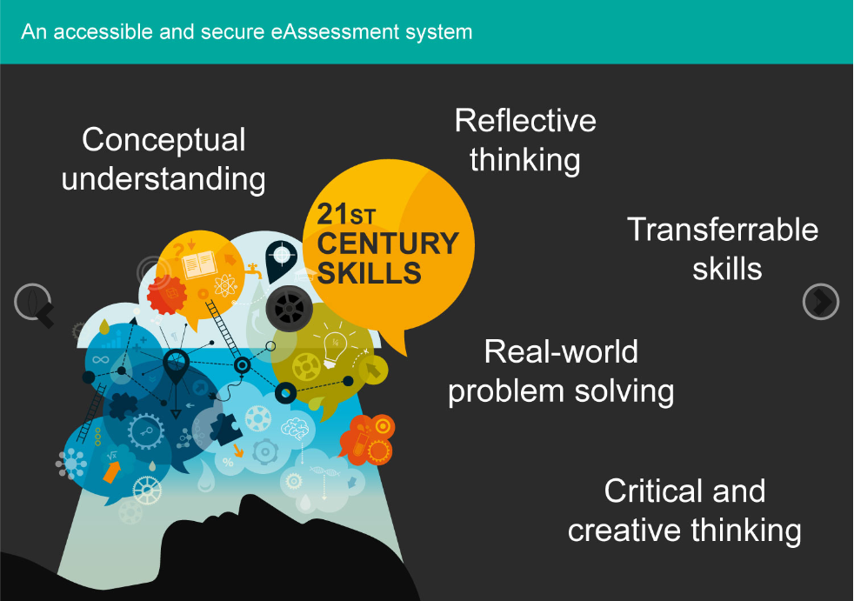
Assessing the important skills
Notes:
With that in mind, the MYP eAssessments have to assess specific skills
The vision of the IB was to use digital technology
to assess contemporary skills
mirrored classroom practice
through inquiry
authentic, real-life contexts.
Why assess digitally?
recognises that MYP students are digital natives who are very familiar with technology, particularly web-based environments
on-screen exams present a real opportunity to assess transferable skills
sophisticated media to simulate authentic contexts

Slide 17
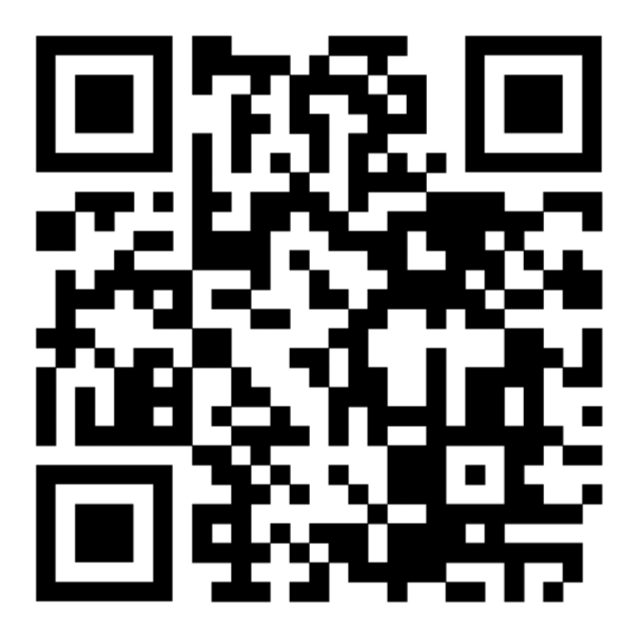
What do MYP on-screen exams look like and what are the tools available?

Slide 18
Wider digital potential

Slide 19


Slide 20
Wider Digital portfolio
Crediting mastery of component skills / learning objectives
Having typed responses facilitates:
Adaptivity – focusing questions that are best for the student in real time
New approaches to marking (with or without human engagement)
Use of IA
Notes:
Students today are digital creatures – writing with a pen for 3 hours is foreign to them
Can just do more in digital world than in paper be it have moving pictures or interactive science experiences were students generate their own data
I don't think that "micro credentials" is how the IB should want to frame it hence "Crediting mastery of component skills" - also why is this digital?
Talk about things like "frequency marking" of short objective answers to avoid concern it is just MCQ, ands using AI to double marking of human examiners.
Also digitals for thinks like spelling checks for students, cut and paste to redraft answers, instant formative feedback etc

Slide 21
Mastery of learning objectives

Slide 22
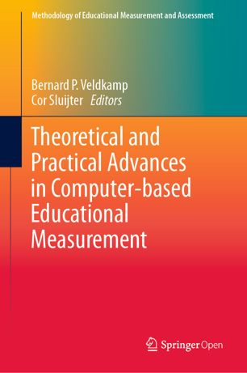
Béguin A.A., Straat J.H. (2019) On the Number of Items in Testing Mastery of Learning Objectives.
In: Veldkamp B., Sluijter C. (eds) Theoretical and Practical Advances in Computer-based Educational Measurement.

Slide 23

Notes:
Sample from a domain with all relevant tasks.
Decent balance over content ➔ stratified sample

Slide 24

Notes:
Number correct is an estimate
percentage correct in total domain

Slide 25
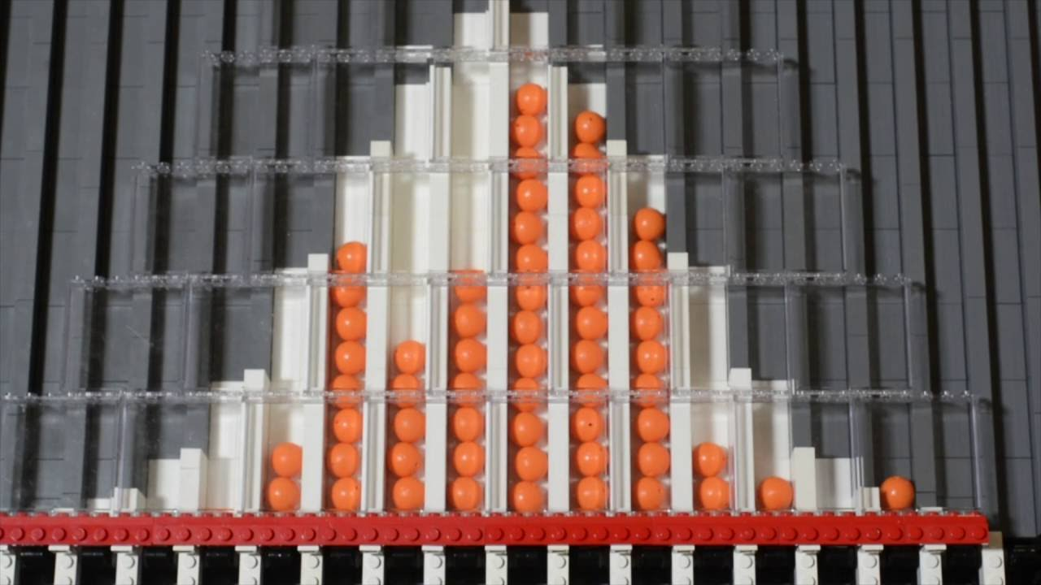
Number of items
Validity of the test
Accuracy of the estimate of percentage correct
Notes:
Larger number of items
cover the content of domain
level out randomness

Slide 26

Notes:
Small number of items
Focus on an aspect

Slide 27
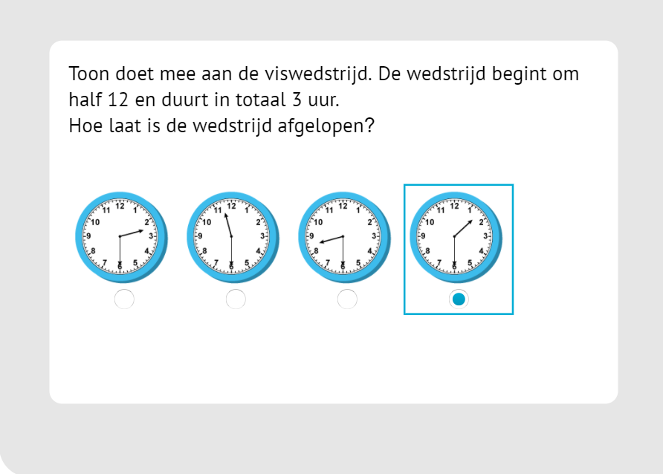
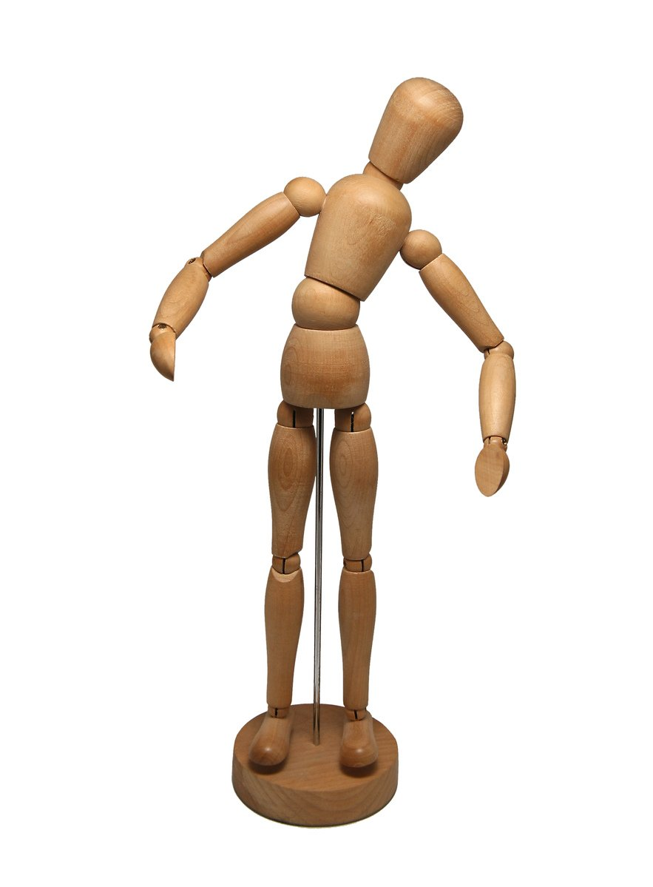
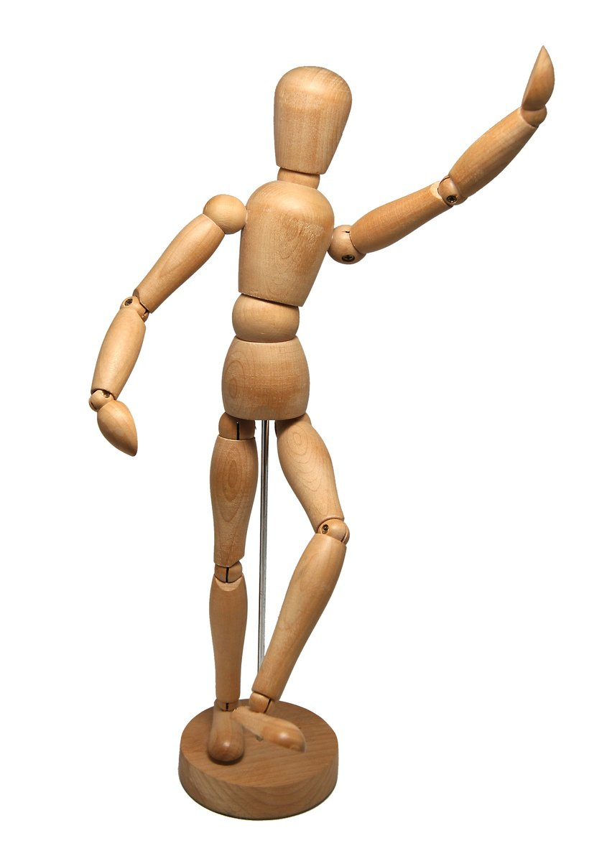
Bayesian hypothesis testing
item
Low probability to give correct answer
High probability to give correct answer
non- master
master
© Cito, 2019
© Cito, 2019

Slide 28
Bayesian hypothesis testing
item
Low probability:
e.g. p < 0.6
High probability:
e.g. p ≥ 0.8
non- master
master
© Cito, 2019
© Cito, 2019

Slide 29
Master or non-master?

Slide 30
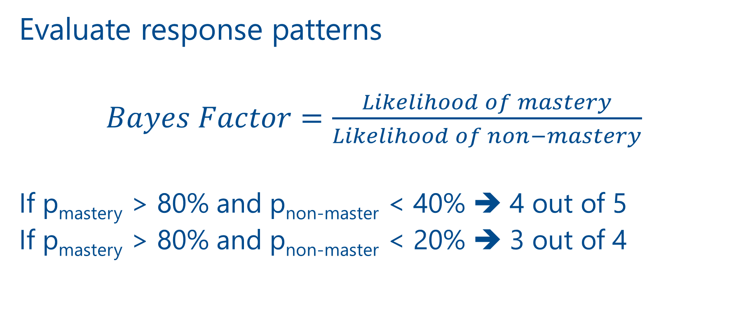
Number correct and test length?
Evaluate response patterns
$Bayes Factor=\frac{Likelihood of mastery}{Likelihood of non−mastery}$
If p_{mastery} > 80% and p_{non-master} < 40% ➔ 4 out of 5
If p_{mastery} > 80% and p_{non-master} < 20% ➔ 3 out of 4
© Cito, 2019

Slide 31
Adaptivity

Slide 32
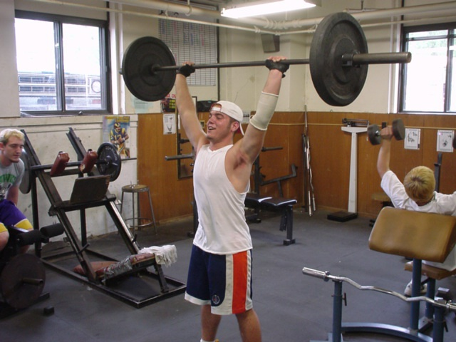
Adaptivity
Adjust the difficulty level of the test based on the performance during the test

Slide 33
Use of IA

Slide 34
Use of IA
Use for marking
  Extensive research
  Works reasonably well…but not based on understanding
  So can be tricked and has flaws
  Not ideal for higher order skills
Text written by Chat-GTP:
  Looks sensible for the first part
  Can contain flaws or potential nonsense
  Are based on existing (potentially older) data
  Are sometimes repetitive

Slide 35

DALL-E
“a teacher being stressed for a high-stakes exam”

Slide 36

DALL-E
“principal being stressed for the high-stakes exams of their students”

Slide 37
Use of IA
Use as support for marking
Think about using tools like ChatGTP as a tool to support writing. For this you can:
  capture the student’s intention
  Evaluate:
    what they gave as input (and iterations)
    how they edited the text
    what they did to verify the validity
Also think about how teachers and educational leaders can use ChatGTP to support them
  Generating (lots of) examples of work for students to evaluate or identify bias
  Reduce time writing lesson plans, routine communications etc

Slide 38
Thank you for your attention!!

